Slide 1

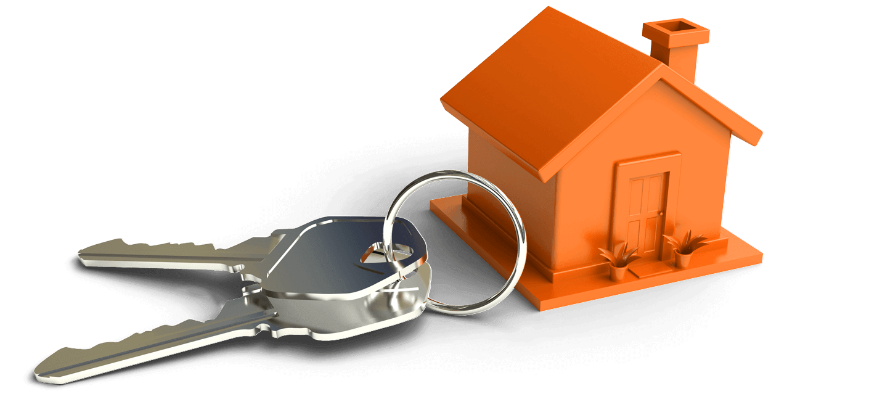
ONLINE
REAL-ESTATE
MANAGEMENT
SYSTEM
- Project By
Group A Batch-99

Slide 2
Team Members
Arifa
Venu Chennamsetty
Deepak Muvvala
Prajwal A C
Dilip S

Slide 3
Problem Statement
Finding properly built and authentic real estate houses which are already well and fully furnished is quite tiresome and difficult most real estate business only build one house or apartment for advertisement then use that one building to convince people to buy house or building that are not even built hence the need of change , this software is to act as a easy way for investors to identify building or apartments that they need hence to avoid instances where one buys a building or apartment which is not built.

Slide 4
Description
Real estate agencies duties include, to give the property on rent or else to sell the property,properties like building, retail sites, flats, houses, bungalows etc. many people search for property for many purposes like residence, offices, etc.
The manual real estate agency follows a real estate is a type of business for selling, buying, renting land, buildings and offices, lengthy and hectic process, people need to meet the agent in person, for checking the property details and also needs to visit the location. it takes long time to look for the desired location and desired type of property.

Slide 5
Thus, we are proposing a Real estate management system to overcome this difficulty. This online Property management system can help you to get best property by just sitting at home or anywhere with a few clicks of the property.
Online real-estate management system mainly includes of Two modules namely Admin and user. Admin can add the property details of buildings, homes, sites etc, and also can add the advertisements of the properties.
User can register and login to the website by using the credentials and can view the properties for rent or buying purpose. He/ she can mark the favourite properties and can also book appointment for visiting the viewed favourite places.

Slide 6
Hardware requirements
PROCESSOR: Core-i3 or more
RAM: 4Gb or Above
SSD: 236Gb or more
SCREEN: 1280x720
Software requirements
Operating System:Windows
Languages: Java[JDBC,JSP,SERVELETS]
Editor: STS-Spring Tool Suite
Webserver: Tomcat server
Database: MYSQL

Slide 7
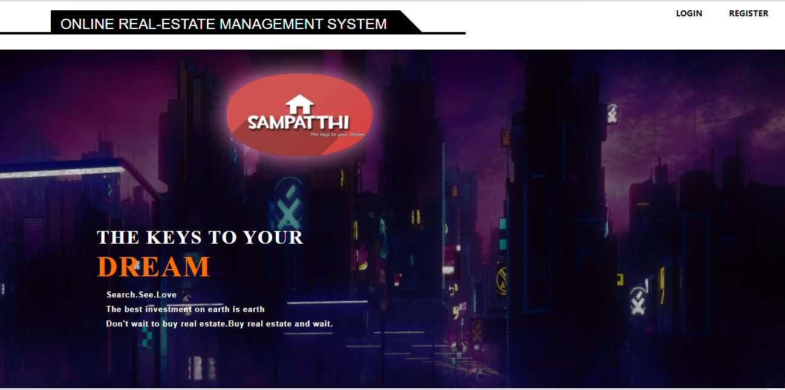
Screenshots of the website

Slide 8
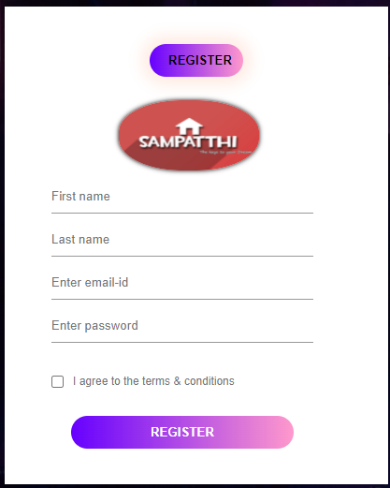

Slide 9
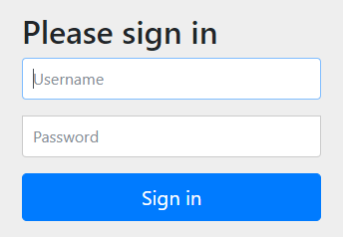
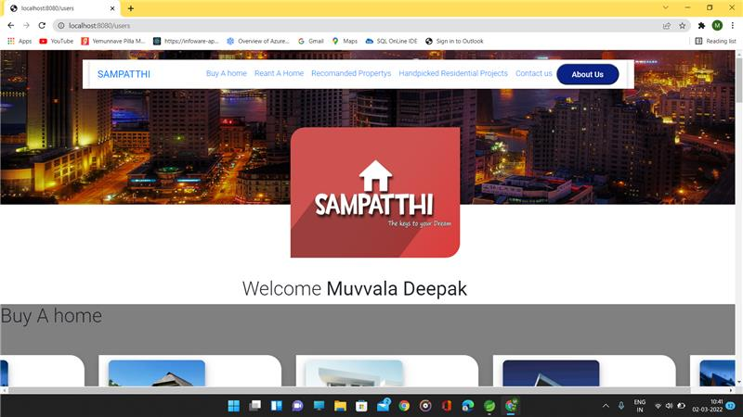

Slide 10
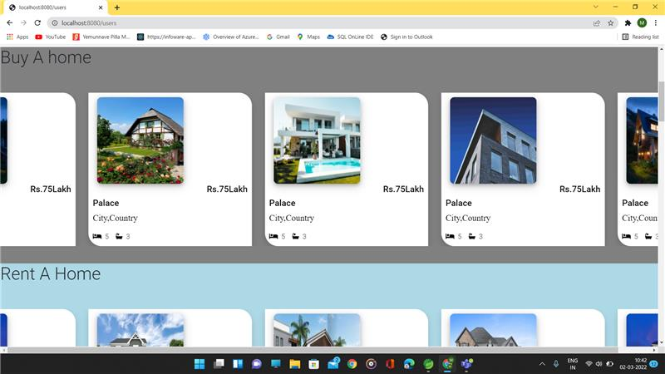
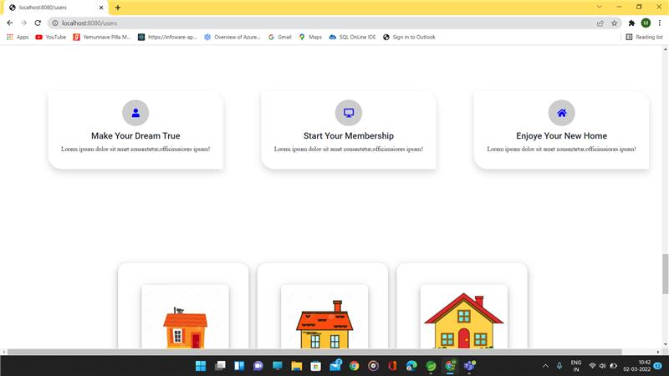

Slide 11
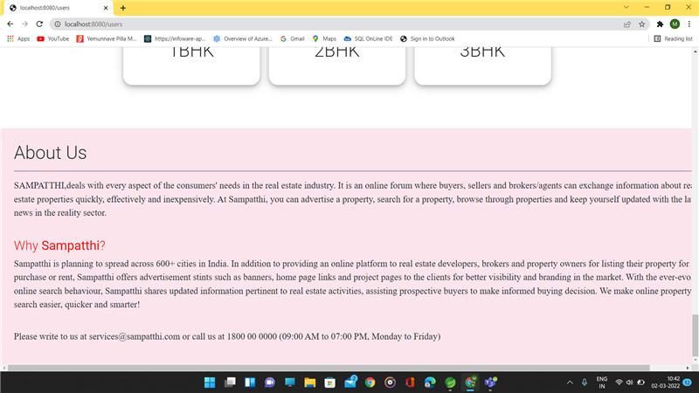
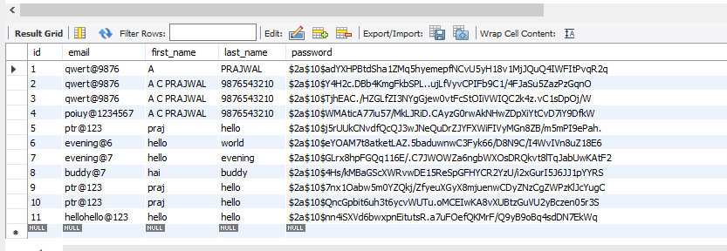

Slide 12
Working Model

Slide 13
THANK YOU

